Slide 1
Early Humans Reteaching/Study Guide Review

Slide 2
1. Archeologists examine artifacts.

Slide 3
2. Historians read diaries and old records to determine cause and effect relationships.

Slide 4
3. Innovations=future/Artificats=past

Slide 5
4. Early civilizations developed near water to sustain life. (crops/animals/people)

Slide 6
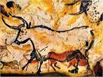
5. Cave art shows us what animals lived then.

Slide 7
6. Paleoanthropologist examine artifacts from early humans.

Slide 8
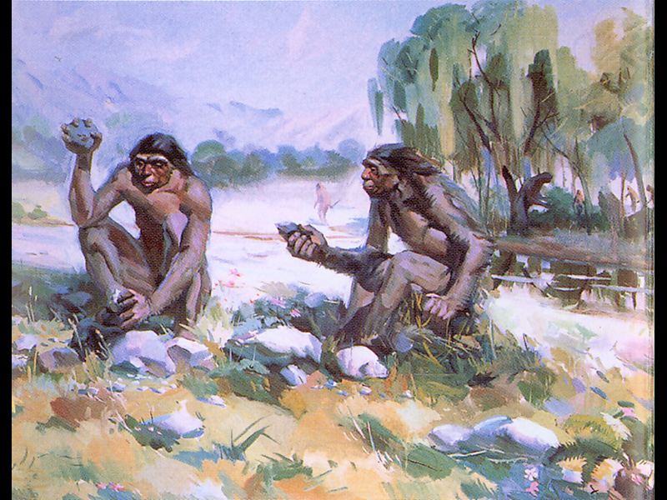
7. Homo habilis had tools which helped them survive.

Slide 9
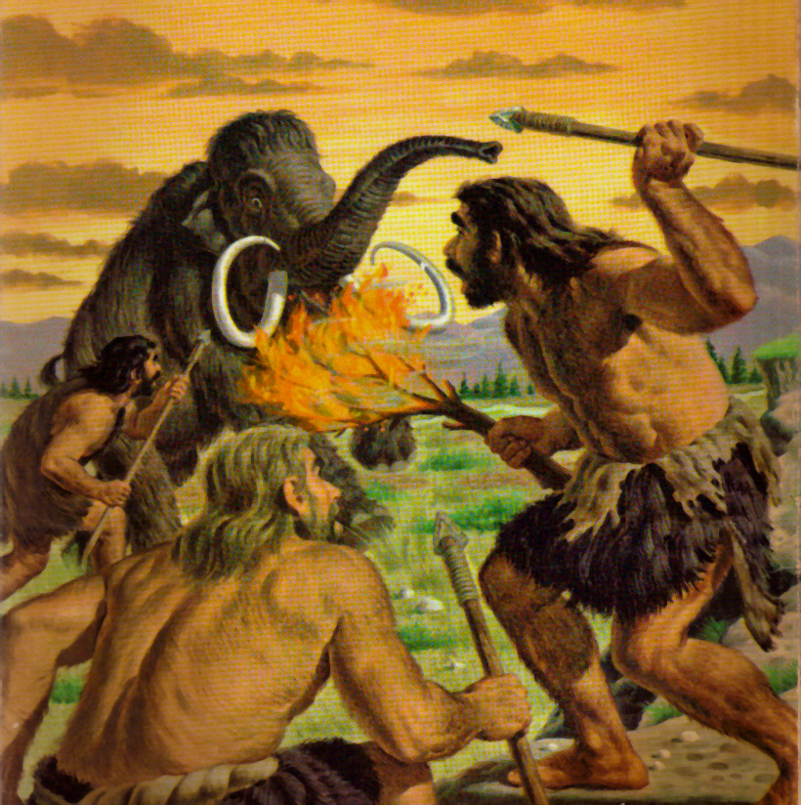
8. Homo habilis were able to survive animal attacks because they lived in groups.

Slide 10
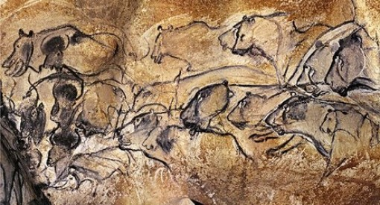
9. Homo sapiens sapiens were more cultural because they created art.

Slide 11
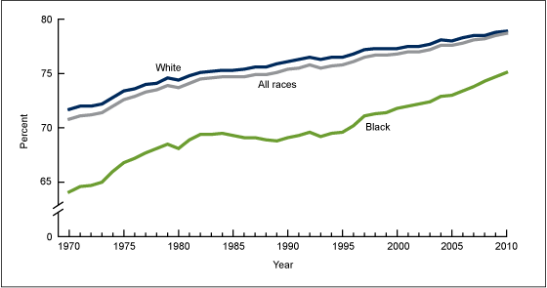
10. New capabilities helped early humans live longer.

Slide 12
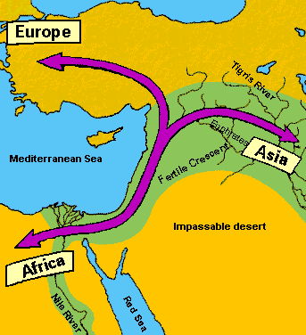
11. Early humans migrated to other continents over land bridges.

Slide 13
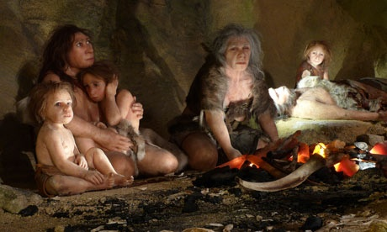
12. Homo sapiens cared for their sick.

Slide 14
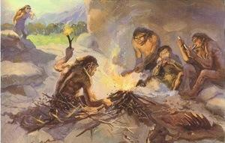
13. Hominids could survive in colder climates because of shelter and fire.

Slide 15
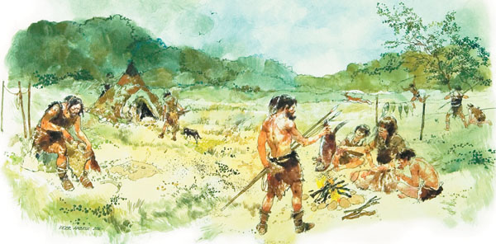
14. Paleolithic=hunter and gatherers

Slide 16
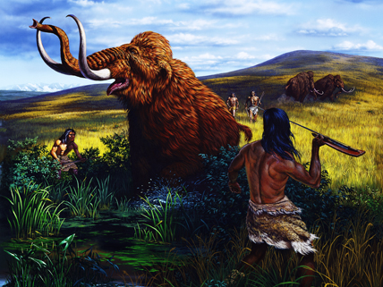
** Early humans migrated to follow the animals (their food supply).

Slide 17
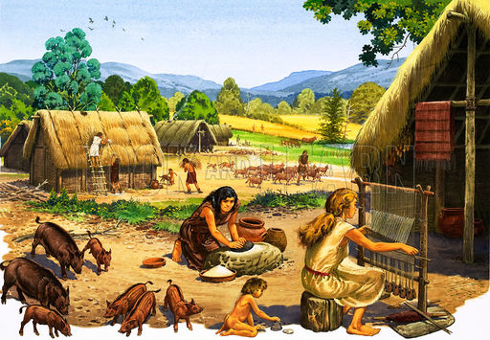
15. Neolithic Age resulted in permanent settlements, specialization, domestication and more trade.

Slide 18
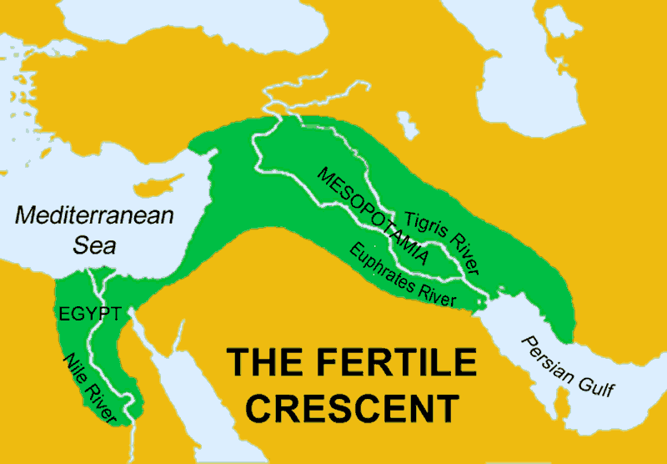
Fertile Crescent=Good soil for farming and fresh water for crops and animals

Slide 19
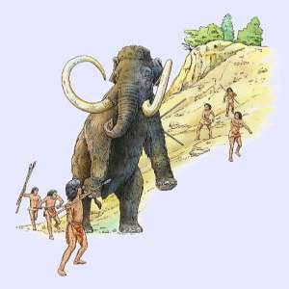
Early humans cooperated so they could be more successful hunting.

