Slide 1
GEOGRAPHICAL JEOPARDY!
Relative vs. Absolute
Geographical Features
5 Themes of Geography
Reading Maps
Misc.
100
100
100
100
100
200
200
200
200
200
300
300
300
300
300
400
400
400
400
400
500
500
500
500
500

Slide 2
100 Point Question
If I flew from Spain to Sweden, I would be going in this direction.
Notes:
Esmerelda

Slide 3

100 Point Answer
What is Northeast?
Notes:
Oliver

Slide 4
200 Point Question
The latitude in Asia is measured in degrees “North” latitude because it is located north of this.
Notes:
John Little

Slide 5
200 Point Answer
What is the Equator.

Slide 6
300 Point Question
We find this using lines of latitude
And longitude, as well as street
addresses.

Slide 7
300 Answer
What is absolute location?

Slide 8
400 Point Question
We find this using cardinal directions, as well as measurements of time and distance.

Slide 9
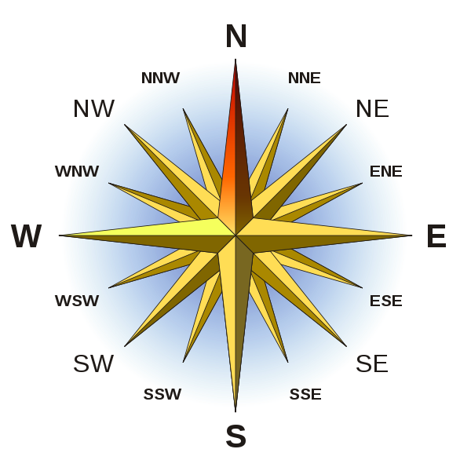
400 Point Answer
What is a relative location?

Slide 10
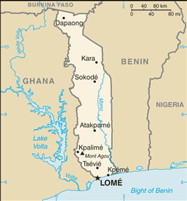
500 Point Question
*CHALLENGE* The country of Togo is located in this hemisphere, in terms of longitude.

Slide 11
500 Point Answer
Where is the EASTERN
Hemisphere.

Slide 12
100 Point Question
This is another name for a valley with very steep sides.

Slide 13
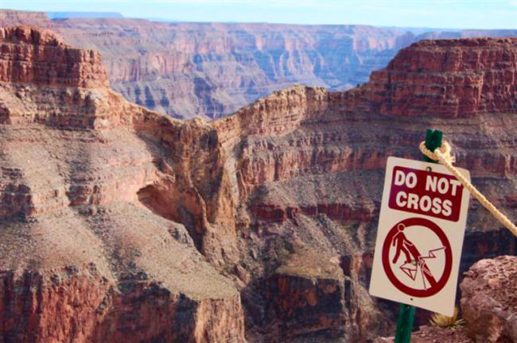
100 Point Answer
What are canyons?

Slide 14
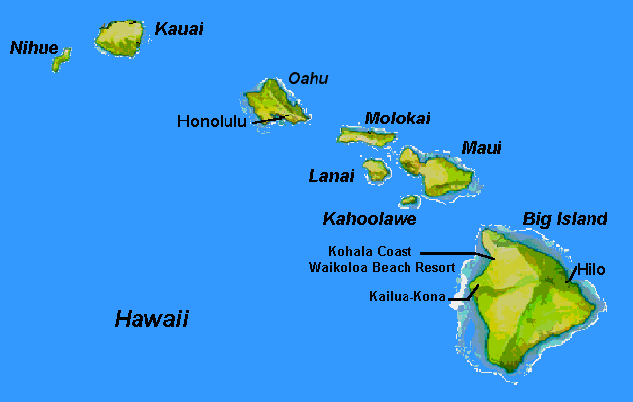
200 Point Question
The state of Hawaii is an
Example of this.

Slide 15
200 Point Answer
What is an archepelago?

Slide 16
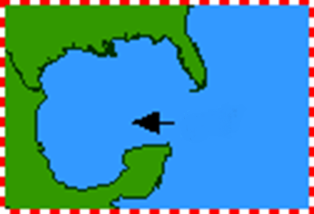
300 Point Question
.
The arrow on this image is pointing to this
Geographical feature.

Slide 17
300 Point Answer
What is a gulf?

Slide 18

400 Point Question
This is a flat area of land higher than the land around it, also known as “tableland”.
.

Slide 19
400 Point Answer
What is a plateau?

Slide 20
500 Point Question
This term, Greek for “neck”, is a narrow strip of land connecting two larger land areas.

Slide 21
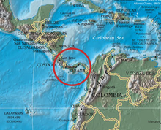
500 Point Answer
What is an isthmus?

Slide 22
100 Point Question
This theme can be found either relatively close, or absolutely positively somewhere.

Slide 23
100 Point Answer
What is location?

Slide 24
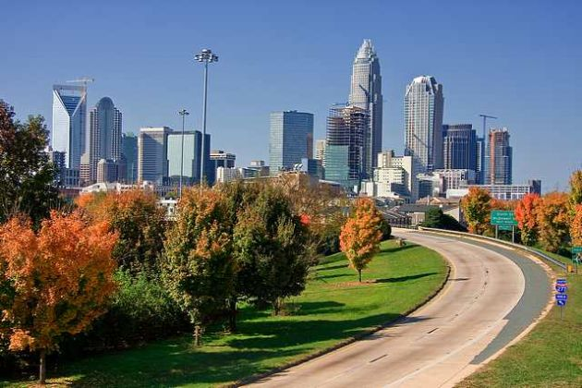
200 Point Question
After the Civil War, the city of Charlotte went through it’s first “boom” after a cotton-processing plant & railroad hub opened. Those are examples of this theme.

Slide 25
200 Point Answer
What is human-environment interaction.

Slide 26
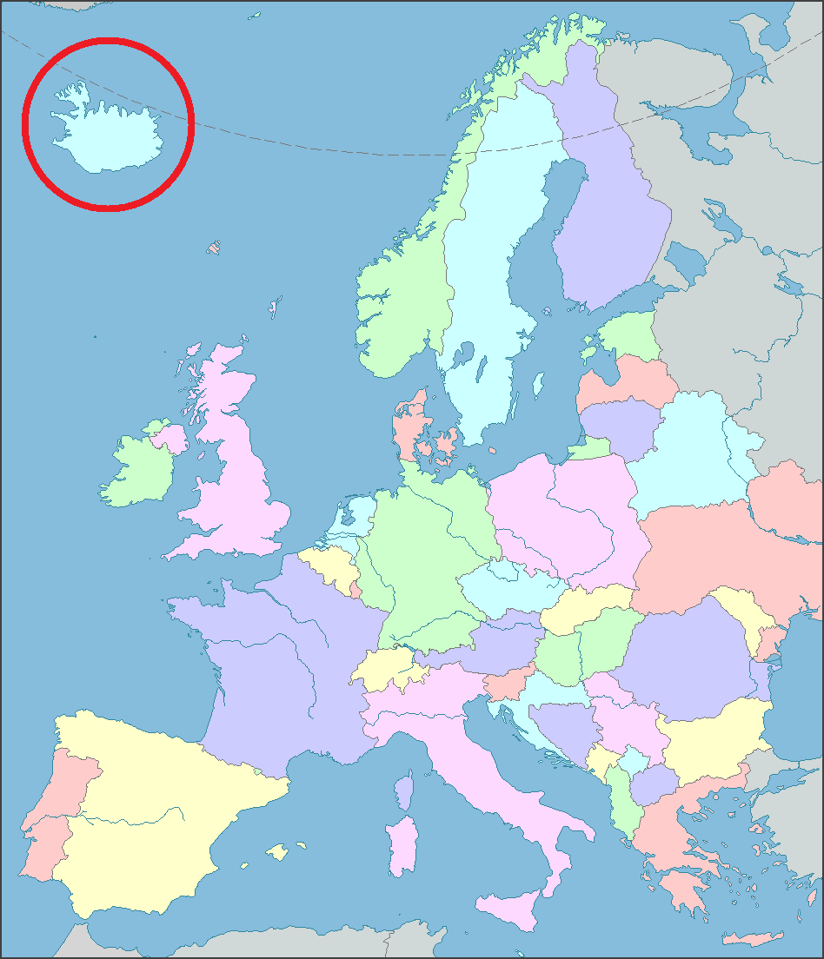
300 Point Question
Because Iceland is far from most of Europe, they must rely on sea or air travel to get goods or people to Europe, which is an example of this theme.

Slide 27
300 Point Answer
What is movement?

Slide 28
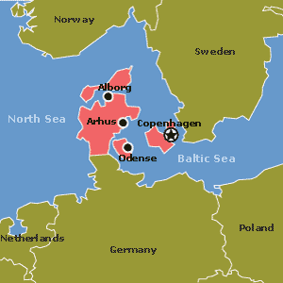
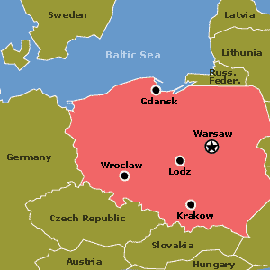
400 Point Question
By comparing Denmark to Poland in terms of this, you could say that unlike Poland, it is a peninsula with a great deal more farmland. They also speak Danish, not Polish.

Slide 29
400 Point Answer
What is place? (physical
& human characteristics).

Slide 30

500 Point Question
DAILY DOUBLE
Because of its status as a city with many job opportunities, many people (like Mr. Donahoe) move here, so many residents wouldn’t have a southern drawl, like residents in nearby rural areas who have lived in NC their whole life. This is an example of this theme.

Slide 31
DAILY DOUBLE ANSWER
What is region?

Slide 32
100 Point Question
This country is the top producer of potatoes in Europe, and its highest elevation is between 0-499 meters.

Slide 33

100 Point Answer
What is Belarus?

Slide 34
200 Point Question
I’m thinking of traveling to the “Apple Capital of Europe” . This is where I will plan my vacation.

Slide 35

200 Point Answer
Where is Moldova?

Slide 36
300 Point Question
This box is featured on each map because it provides the map reader with a means of understanding the map’s content.

Slide 37
300 Point Answer
What is a key/legend?

Slide 38
400 Point Question
By reading the title and key, as well as keeping an eye out for color coding and/or symbols, I should easily be able to figure out the content of this type of map.

Slide 39
400 Point Answer
What is a thematic map?

Slide 40
500 Point Question
This country would have the most abundant and diversified amount of resources in Europe, according to the maps on the study guide.

Slide 41

500 Point Answer
Where is France?

Slide 42
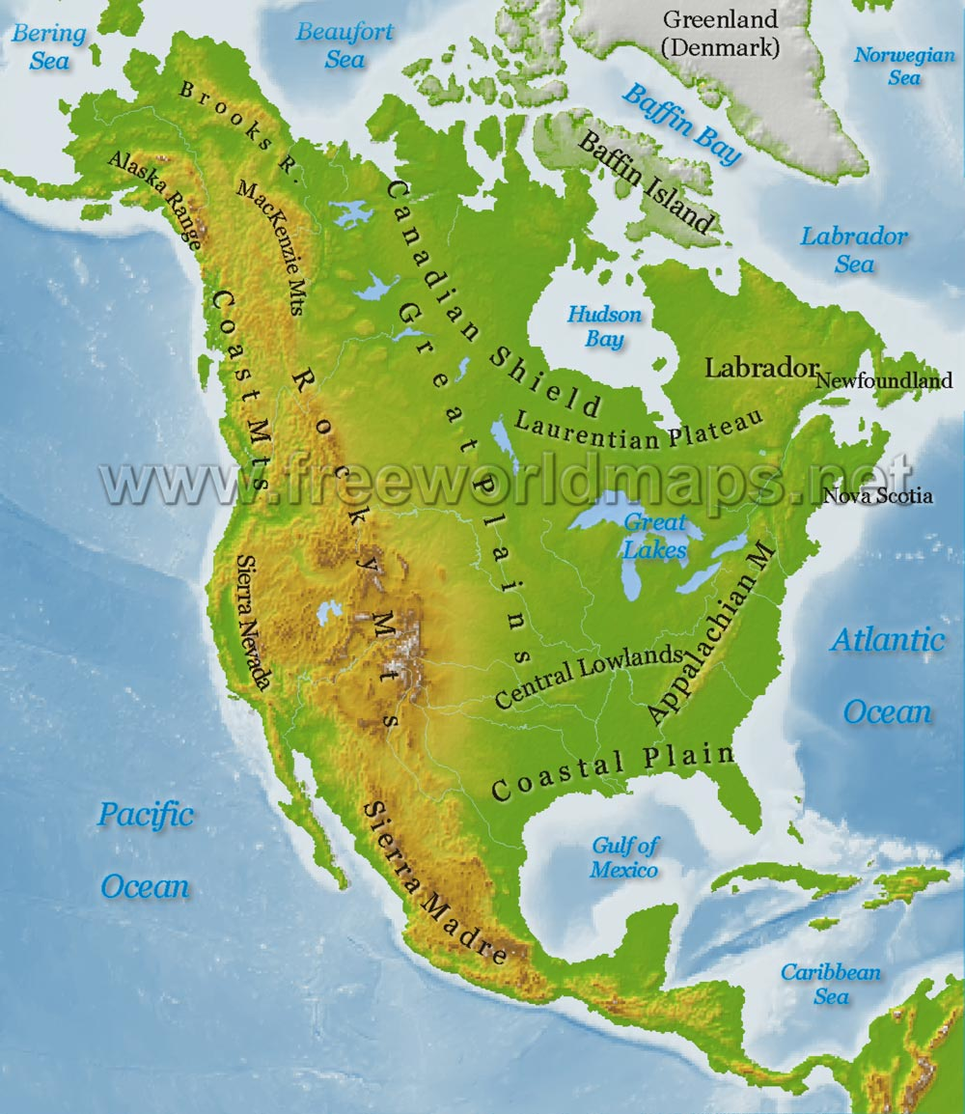
100 Point Question
The above image is an example of this type of map.

Slide 43
100 Point Answer
What is a physical map?

Slide 44
200 Point Question
One half of the globe can also
be referred to as this.

Slide 45
200 Point Answer
What is a “hemi”sphere?

Slide 46
300 Point Question
This type of map would feature
Land borders, countries, cities, and states.

Slide 47
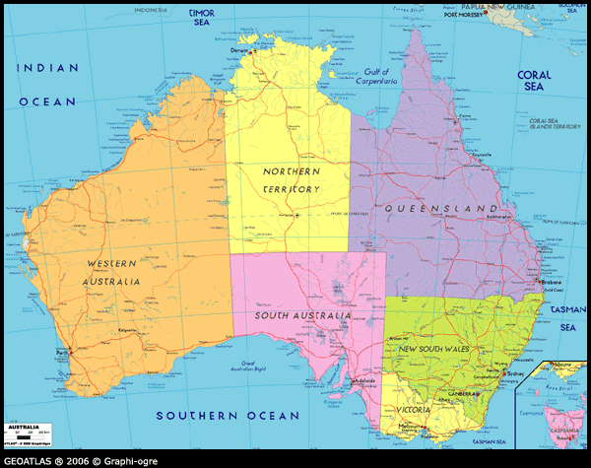
300 Point Answer
What is an a political map?

Slide 48
400 Point Question
By 2018, this mine in Mongolia
Is expected to account for more than
A third of Mongolia’s economic output,
And will be among the top three copper-gold
Mines in the entire world.

Slide 49
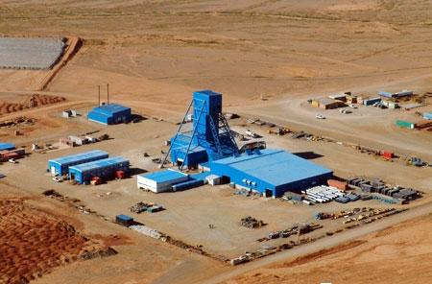

400 Point Answer
What is the Oyu Tolgoi mine?

Slide 50
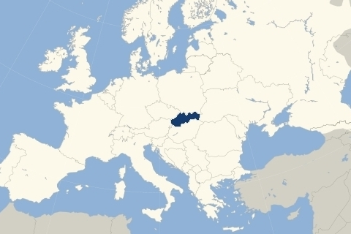
500 Point Question
Slovakia is an example of this type of country,
In terms of its geographical features.

Slide 51
500 Point Answer
What is landlocked?

